Slide 1





YOUR LOGO
Education
University
01
Presentation on BStack demo Website
Project Title: BStack demo Project
Team : Individual Project
Name : Dhana sri sanjana penugonda
Guidence : Vishali sonanis
Date : 09/08/2025
PRESENTATION

Slide 2

Introduction
BrowserStack is a website that helps software developers and testers check if websites and apps work correctly on many different devices and browsers

Slide 3
YOUR LOGO
Responsibilities
* Reserch the BStack demo website each and every part
* Write test cases for each module
* Write test plan for each module
* Execute testcases
* Write defect report

Slide 4
YOUR LOGO
University
Overview
* bstack demo website is a practice site made by BrowserStack for testers and developers
* It looks like a regular online shop, so users can test things like searching for products, logging in, adding to cart, and placing orders
Presentations are communication tools

Slide 5
YOUR LOGO
Education
University
Modules
Module 1: Login
To check user is able to login into the website using valid credintials
Module 2: Search for product
To verify search button is working or not for customer requirements

Slide 6
YOUR LOGO
Education
University
Module 3: Add to cart
After adding the product into the cart to check product is added or not
Module 4: Delete from the cart
After removing the product from the cart, check if the product is successfully removed or not.

Slide 7
YOUR LOGO
Education
University
Module 5: Offers
After applying an offer or coupon code, check if the discount is applied correctly to the total amount.
Module 6: Orders
After placing an order check if the order is successfully added into the orders

Slide 8
YOUR LOGO
Education
University
Module 7: Order by
After applying the sort check if the product list is rearranged according to the selected sorting rule
Module 8: Favourites
After clicking product into favourites verify that the product is added to the favourites list
Graduate Thesis Defense PPT Template
PRESENTATION

Slide 9
YOUR LOGO
Education
University
Module 9: Checkoutpage
Confirm that delivery address fields accept valid input and provide error messages for invalid data.
Module 10: Logout
Verify that the user is successfully logged out and redirected to the home page.

Slide 10
YOUR LOGO
Education
University
DEFECTS
During test execution some fields do not behave as expected it indicating issues or defects. I have created test plan documented for these problems by creating detailed defect reports for each module.

Slide 11
Education
University
Defect identifier :- BStack demo_001
Defect summary :- Expected output: After searching the product(iphone12) it should desplay only iphone 12 Actual output: It showing another products also like galaxy s9,s10
Test Id :- TC_002
Ø Test case name :- TC_Searching
Ø Module name :- Search
Ø Reproducible :- Search for iphone 12
Ø Severity :- high
Ø Priority :- high
Ø Raised by :- Sanjana
Ø Assigned to :- developer Team lead
Ø Date of assignment :-
Ø Status :- pending
Ø Snap shots :-
Ø Fixed by :- developer
Ø Date of fixing :-

Slide 12

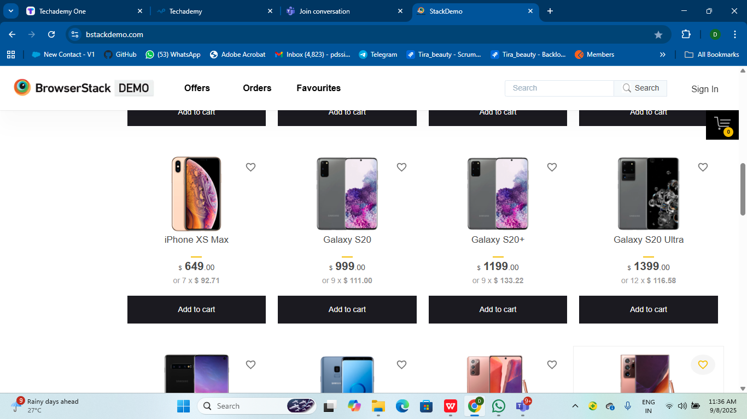
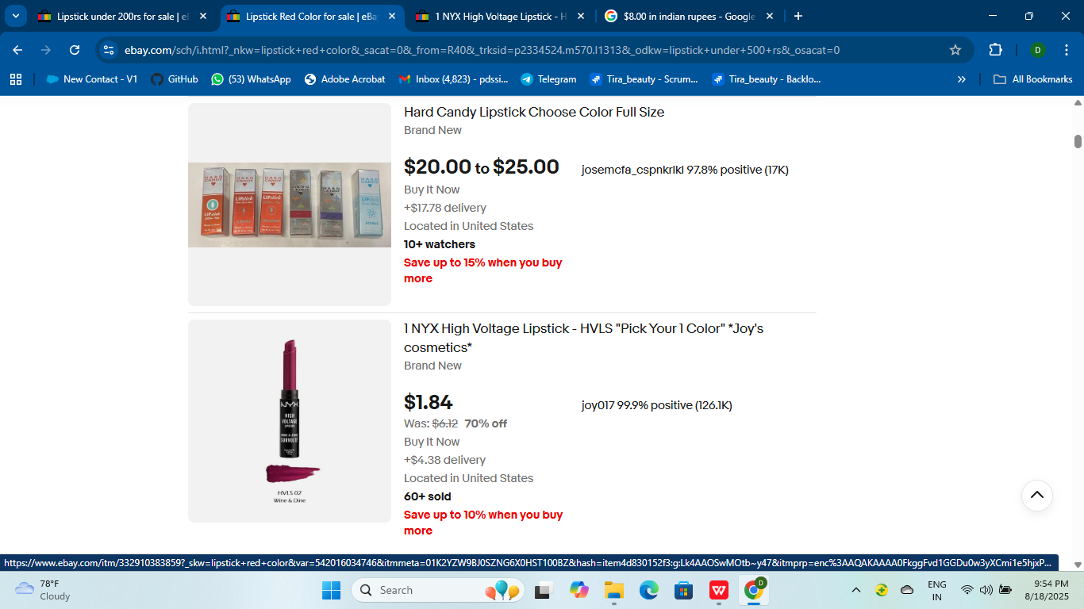
YOUR LOGO
Education
University
Part 3
Achievement display
Graduate Thesis Defense PPT Template
Presentations are communication tools that can be used as speeches, reports, and more.
Graduate Thesis Defense PPT Template
PRESENTATION

Slide 13
Defect identifier :- BStack demo_002
Defect summary :- Expected output: After entering the username 5(locked_user) and password it should be login to home page Actual output: It is displaying "Your account is locked"
Test Id :- TC_008
Ø Test case name :- TC_login
Ø Module name :- Login
Ø Reproducible :- Enter username(lockec_user) and password
Ø Severity :- High
Ø Priority :- Medium
Ø Raised by :- Sanjana
Ø Assigned to :- developer Team lead
Ø Date of assignment :-
Ø Status :- pending
Ø Snap shots :-
Ø Fixed by :- developer
Ø Date of fixing :-
Education
University

Slide 14
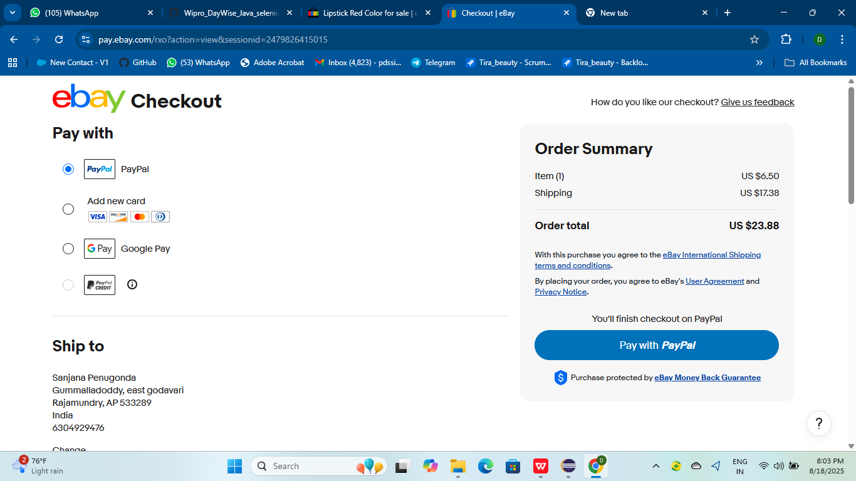
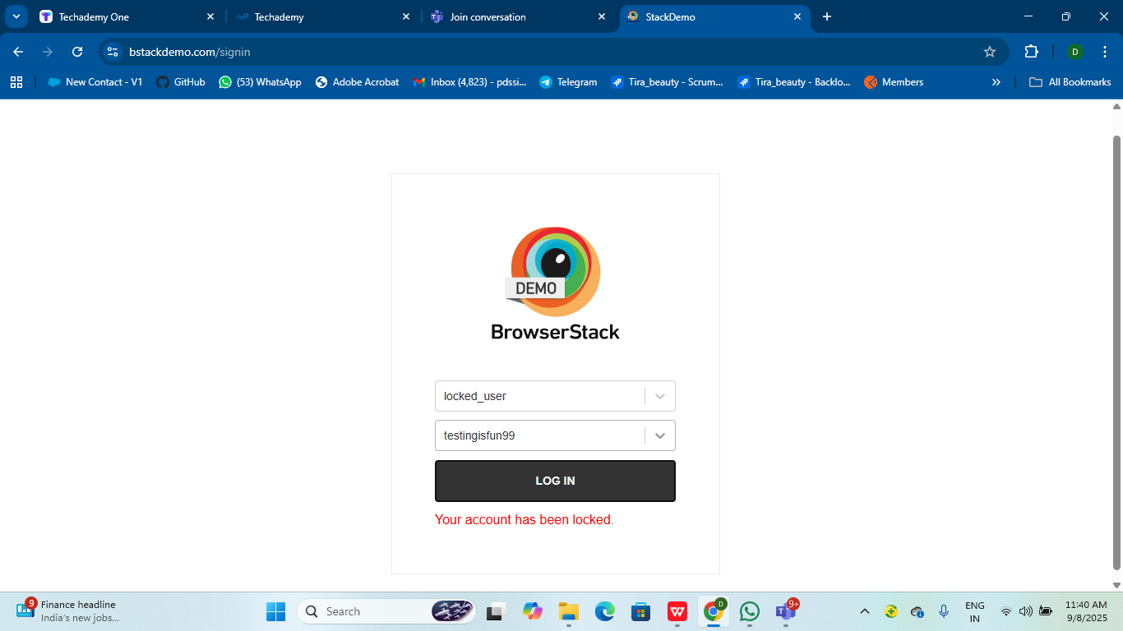


YOUR LOGO
Education
University
Achievement display
Description
Description
28%
Presentations are communication tools that can be used as demonstrations, lectures, speeches, reports, and more.
Presentations are communication tools that can be used as demonstrations, lectures, speeches, reports, and more.
32,495
32,495

Slide 15
YOUR LOGO
Education
University
Challenges
*Handling the entire project on my own was challenging especially managing time and responsibilities but it strengthened my problem solving abilities
*While writing the test cases for login module taking the locators is very difficult and it takes a lot of time.
* Making all decisions by alone it is some difficult

Slide 16
YOUR LOGO
Education
University
Experience
* Through this project I learned both automation testing and manual testing as well as how to use Jenkins
* Managing the test reports generated by Jenkins helped me understand how to track test results efficiently
* Using Cucumber BDD made it easier to write clear and understandable test scenarios in plain English.
Graduate Thesis Defense PPT Template
PRESENTATION

Slide 17
YOUR LOGO
Education
University
Thank you
For watching
Vaishali Mam For Guiding me through out the Project.
PRESENTATION

